Slide 1
Periodic table

Slide 2
Week 6
Which direction(s) would you’d expect this particle to be accelerated?
+

Slide 3
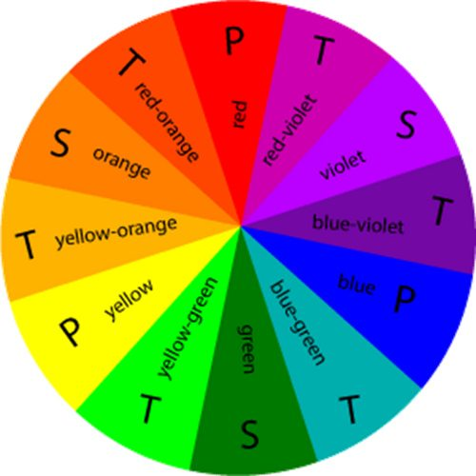
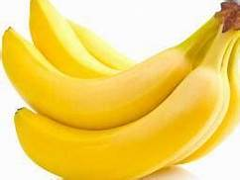
Week 6
What energy (eV) of light would you’d expect these bananas to reflect, and what energy would you expect them to absorb?
1.8 eV
2.1 eV
3.6 eV
3.3 eV
2.4 eV
2.7 eV
3.0 eV

Slide 4
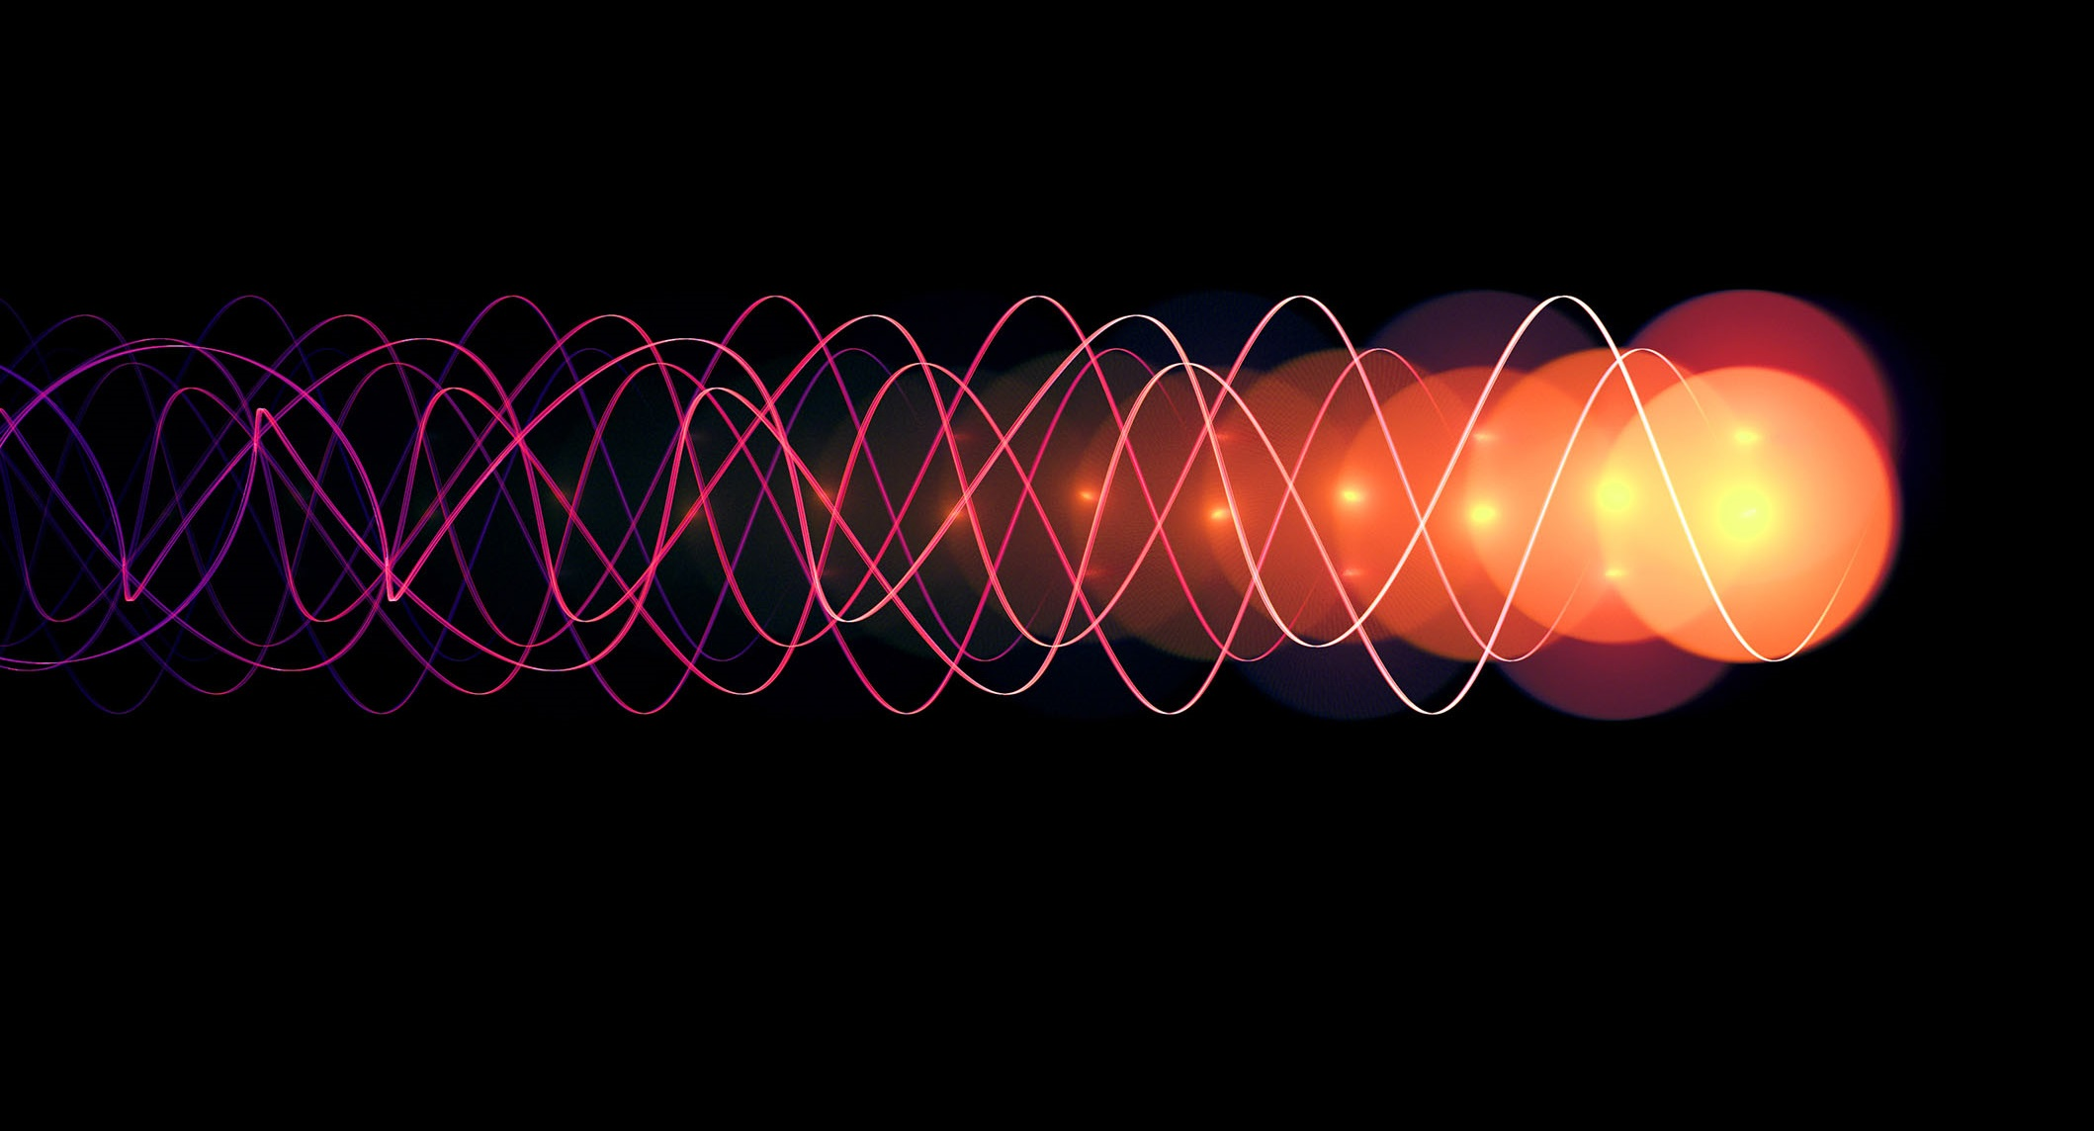
Week 6
Which of these waves of light would you expect to have higher frequency? Which would be associated with photons that pack the most energy?

Slide 5
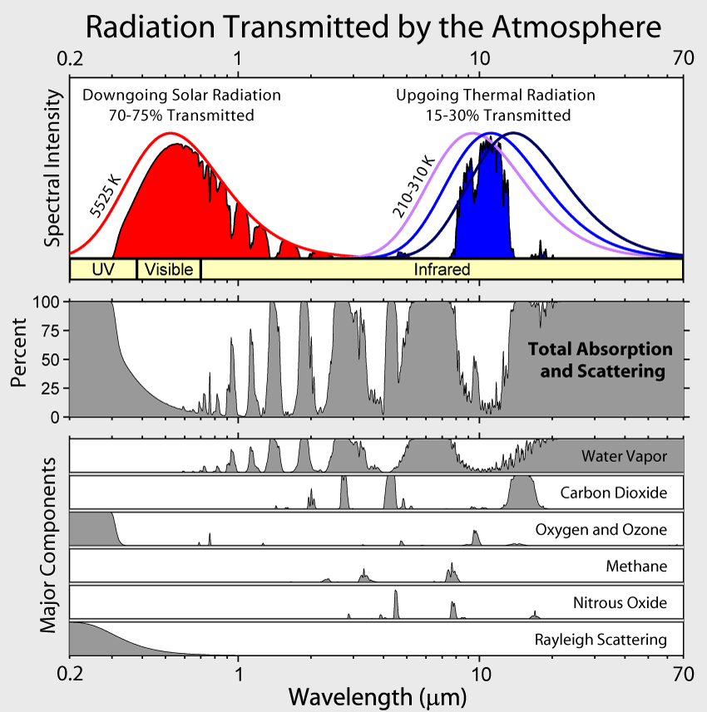
Week 6
Explain how you’d calculate the temperature of the surface that is emitting the red-colored blackbody curve (and then calculate it)

Slide 6
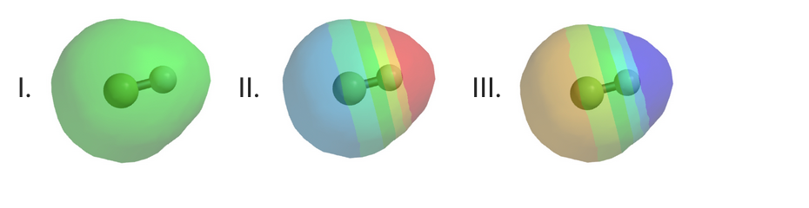
Week 7
In the molecule HCl, the atom most likely to have a partial negative charge is ___ H or ___ Cl.
Of the three possible electrostatic potential maps of the molecule HF shown below, which is the most plausible?
H
H
H
F
F
F

Slide 7
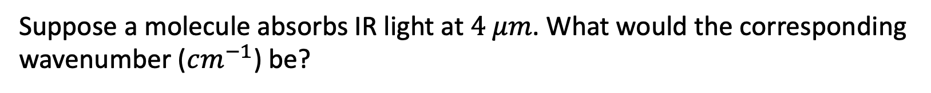
Week 7
Suppose a molecule absorbs IR light at $4 μm$. What would the corresponding wavenumber ($cm^{−1}$) be?

Slide 8
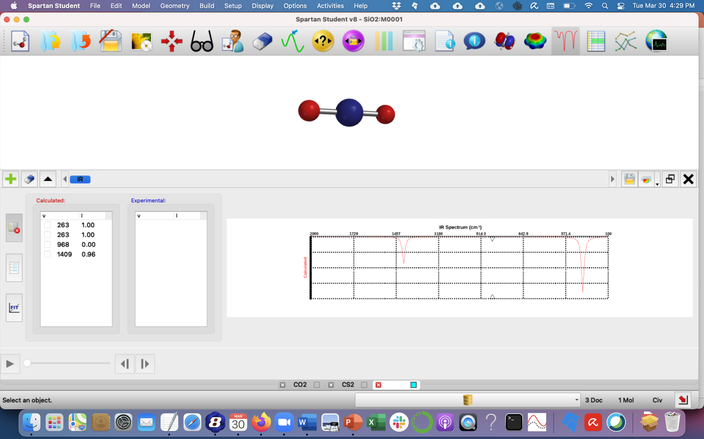
Week 7
Identify the wavenumber(s) of any IR-active modes in SiO₂, and how you come to that conclusion

Slide 9
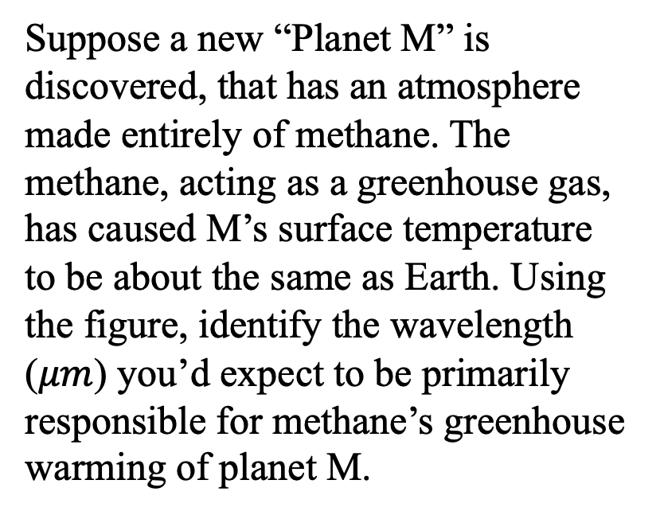
Week 7
Suppose a new “Planet M” is discovered, that has an atmosphere made entirely of methane. The methane, acting as a greenhouse gas, has caused M’s surface temperature to be about the same as Earth. Using the figure, identify the wavelength ($μm$) you’d expect to be primarily responsible for methane’s greenhouse warming of planet M.

Slide 10
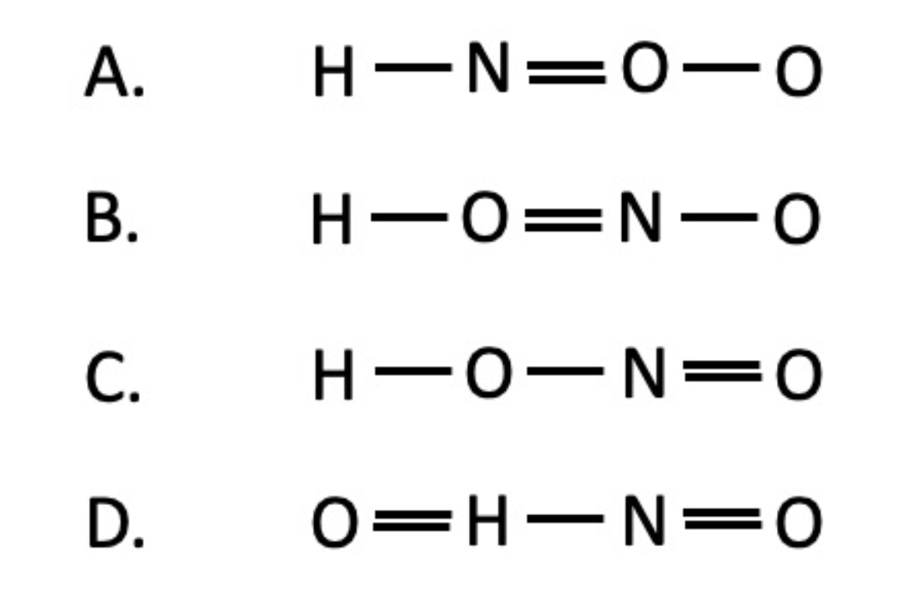
Week 8
What’s the best connectivity of this molecule (HNO₂)?

Slide 11
Week 8
Sketch a Lewis structure for N₂

Slide 12
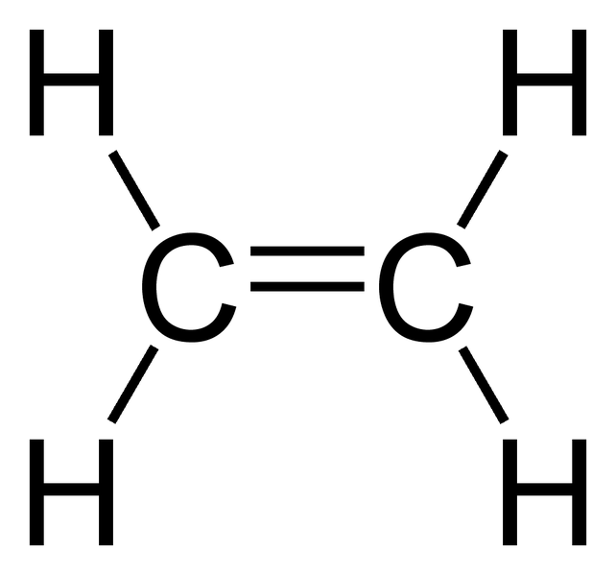
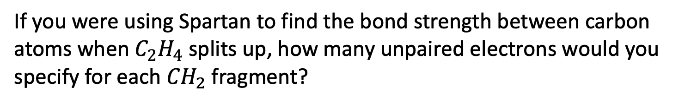
Week 8
If you were using Spartan to find the bond strength between carbon atoms when $C_{2}H_{4}$ splits up, how many unpaired electrons would you specify for each ${CH}_{2}$fragment?
+

Slide 13
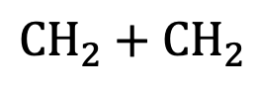
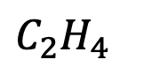
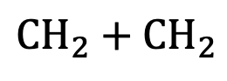
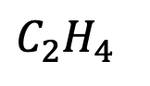
Look at these diagrams, choose (and explain your choice) …
The first is plausible, the second definitely not
The second is plausible, the first definitely not
Both are plausible
Neither is plausible
Week 8
$${CH}_{2}+{ CH}_{2}$$
Energy
$$C_{2}H_{4}$$
Reaction Progress
Energy
$$C_{2}H_{4}$$
$${CH}_{2}+{ CH}_{2}$$
Reaction Progress

Slide 14
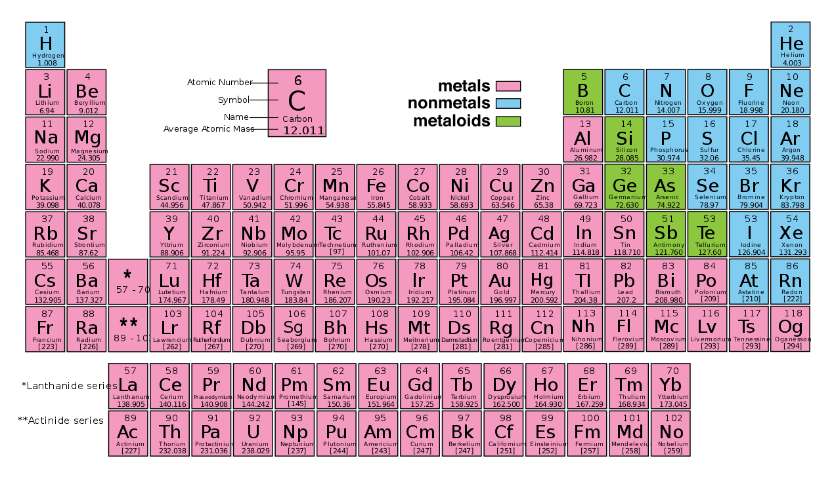
Week 10
Name four elements for which the octet rule is thought to be valid; (ignore the noble gases, on the right.)

Slide 15
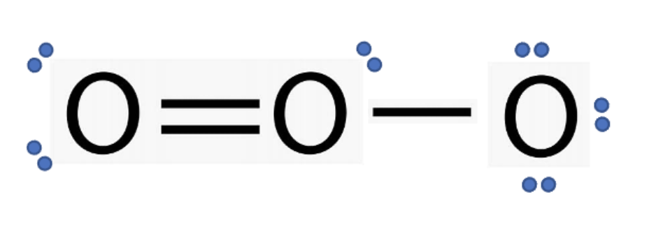
Week 10
In this Lewis structure, which electrons could be called an allylic lone pair?

Slide 16
Week 10
In this Lewis structure, what is the formal charge on these atoms?
FC =
FC =

Slide 17
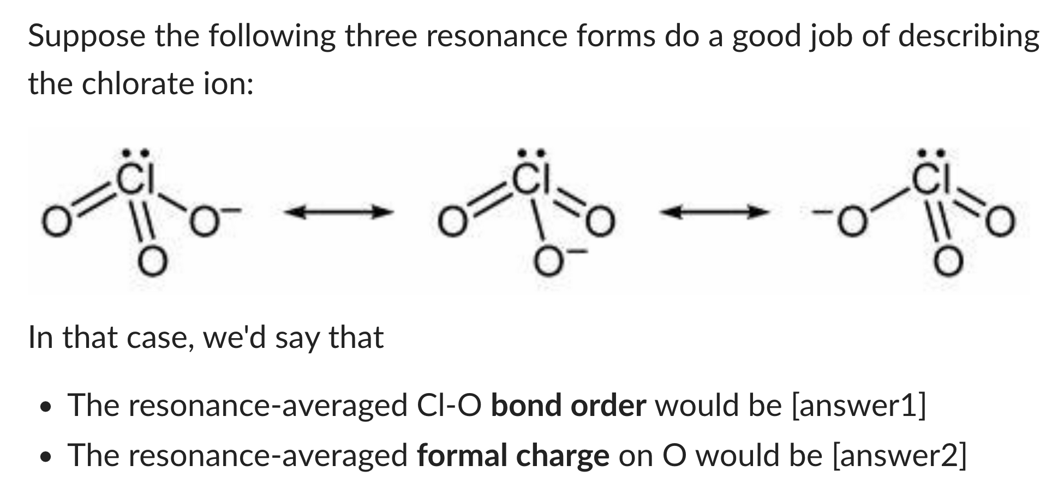
Week 10

Slide 18
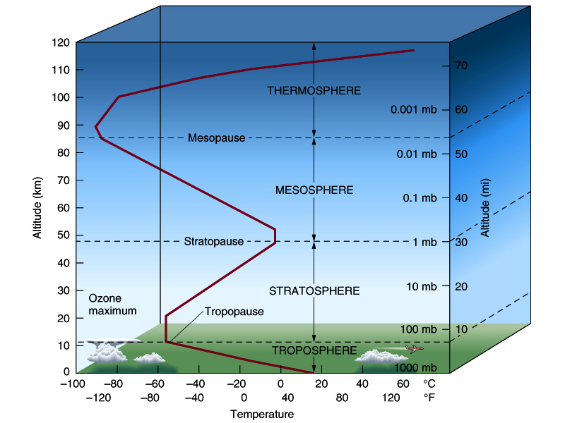
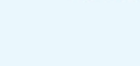
Week 10
Where is most of Earth’s ozone?
D
C
B
A

Slide 19
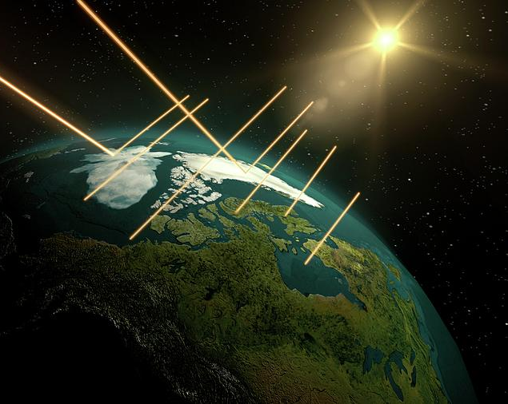
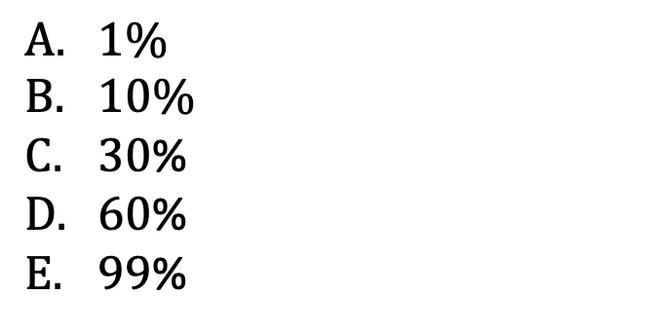
Week 11
What’s the best estimate for the overall albedo of Earth (including atmosphere, land, and oceans)?
$1\%$
$10\%$
$30$%
$60$%
$99$%

Slide 20
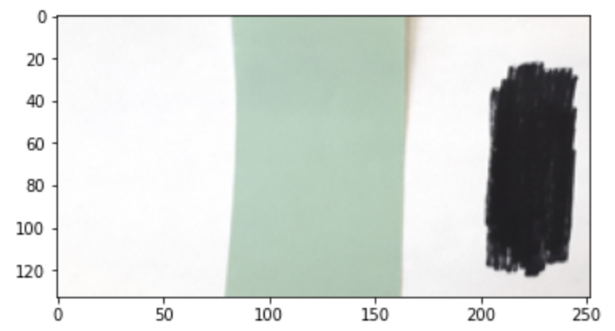
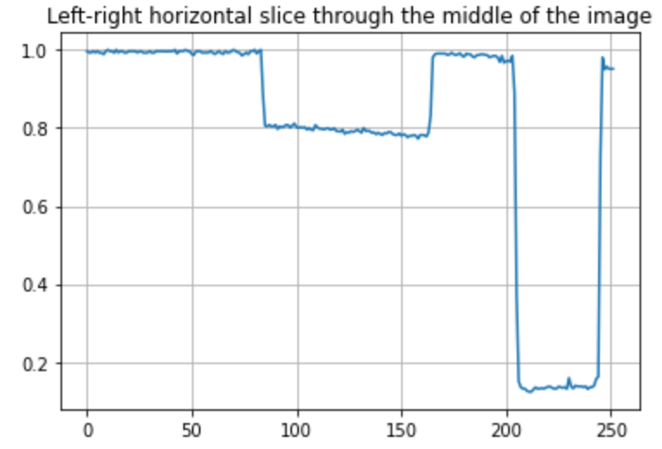
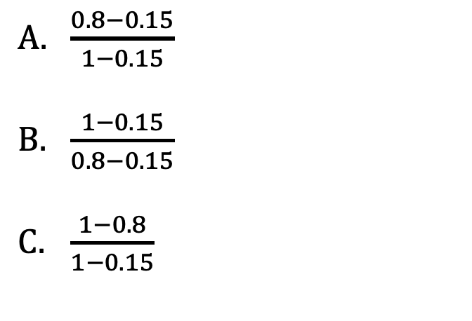
Week 11
Based on the image at left, which is the correct formula for calculating the albedo of the green paper?
Image
$\frac{0.8−0.15}{1−0.15}$
$\frac{1−0.15}{0.8−0.15}$
$\frac{1−0.8}{1−0.15}$
Intensity of reflected light (arbitrary units)

Slide 21
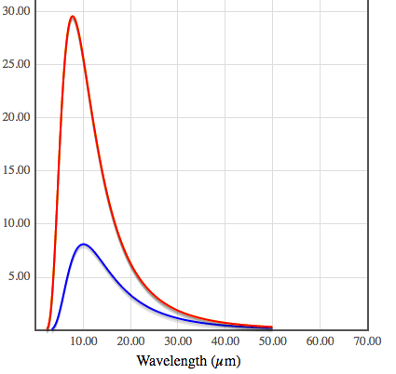
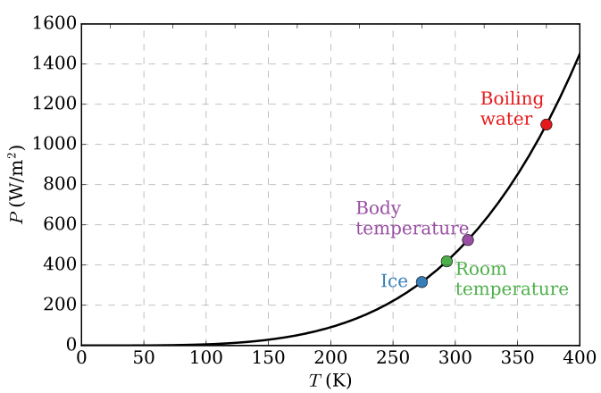
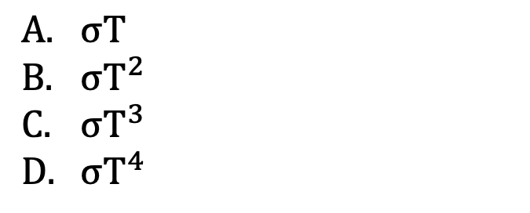
Week 11
The Stefan-Boltzmann power (total energy emitted by each square meter of an object) is given by which formula?
$σT$
$σT^{2}$
$σT^{3}$
$σT^{4}$
Stefan-Boltzmann power

Slide 22
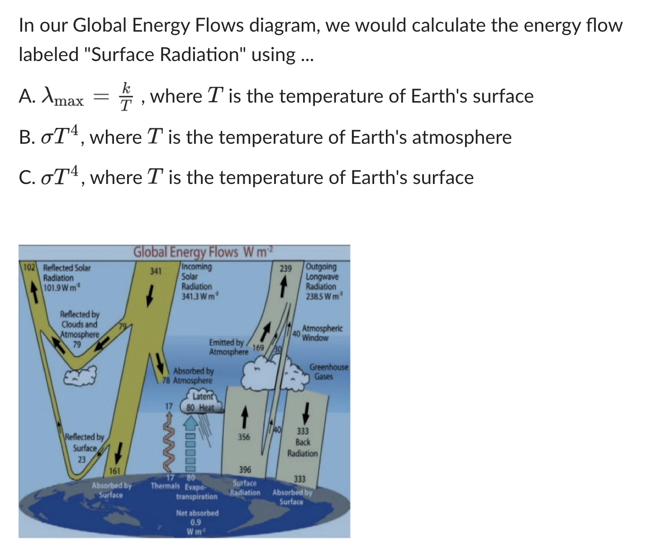
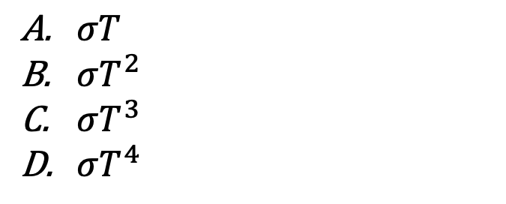
Week 11
$σT$
$σT^{2}$
$σT^{3}$
$σT^{4}$

